Slide 1
Cycle Statistic Tool
Cody Klingler & Jacob Hoffman

Slide 2
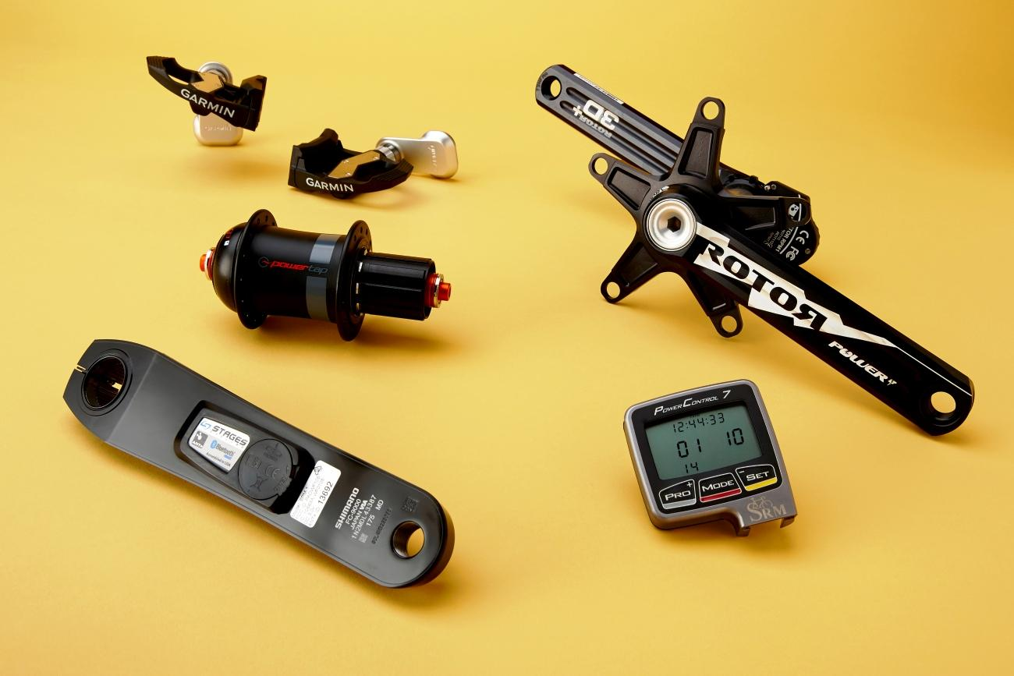
PROBLEM
Available bicycle meters offer very few measurements.
Smart devices do not offer accurate live measurements beyond speed and location.
Cyclists require a better, more encompassing solution for setting goals and tracking improvement.
Notes:
Bicycle meter are tools that allow you measure information about a bicycle as you ride it.
To cyclists, one of the most valuable statistics is power output. Current power meters are expensive ($400) and offer little beyond measuring power.
Smart devices are limited to general information about your cycling like location, speed, and heartbeat.

Slide 3
SOLUTION
Sensors and components may be used to create a device designed to provide a large collection of cycling data.
Attaching sensors and components directly to the bicycle allows for more specific cycling data to be measured.
Transmitting cycling data to a companion application will provide record of each cycling session for use in improving a user’s cycling skills.

Slide 4
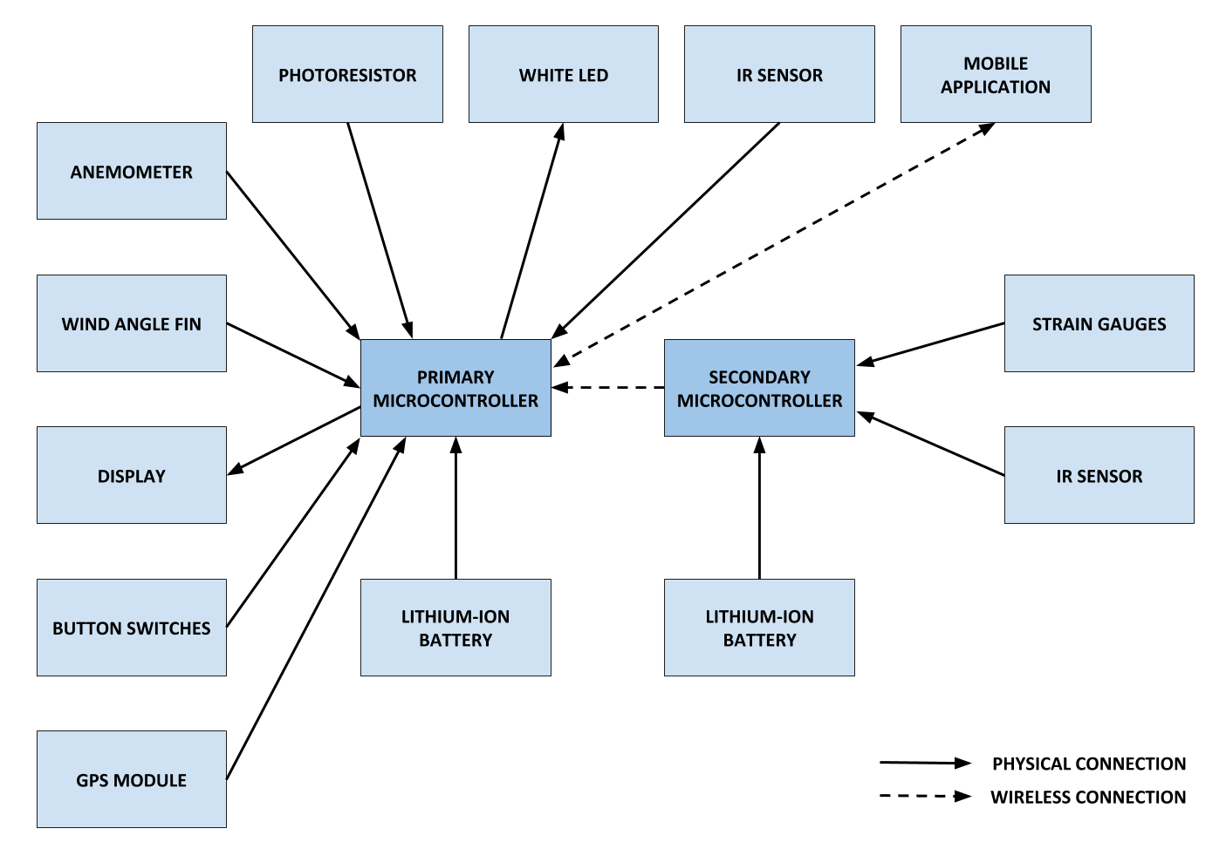
BLOCK DIAGRAM

Slide 5
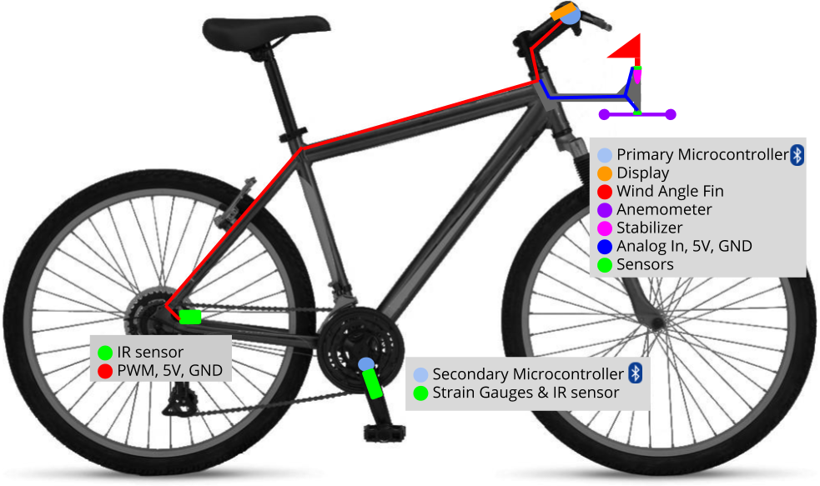
SKETCH

Slide 6
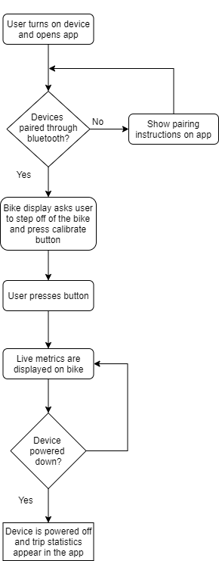
FLOWCHART

Slide 7
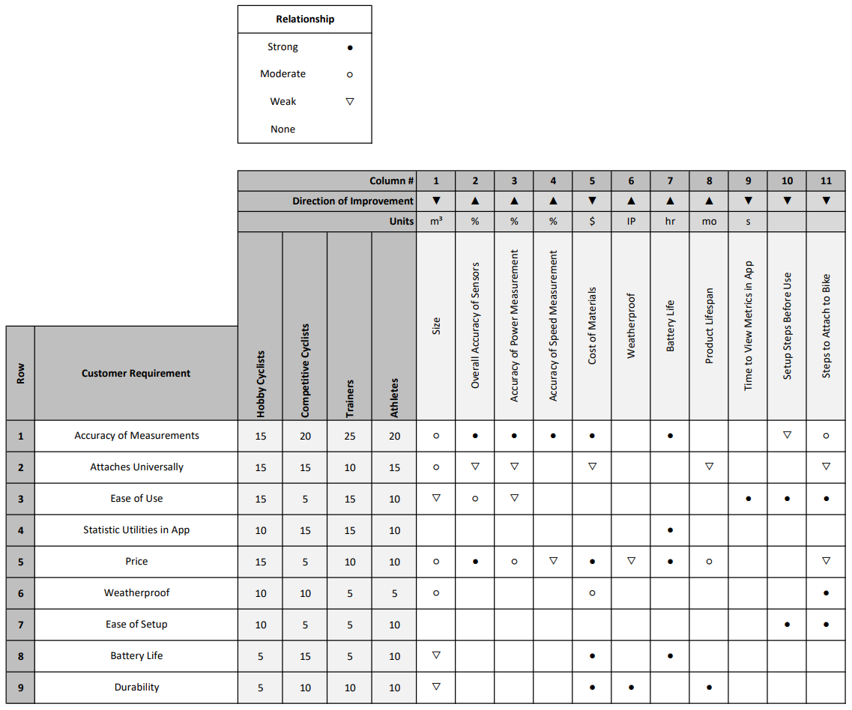
FUNCTIONAL
REQUIREMENTS

Slide 8
ENGINEERING SPECIFICATION
Engineering Specification | Unit | Direction | Target | Threshold
Size Ease of use | m³ | ▼ | .2 | .5
Overall Accuracy of Sensors Accuracy of measurements Price Battery life | % | ▲ | 90 | 80
Accuracy of Power Metric Accuracy of measurements Price Battery life | % | ▲ | 90 | 75
Accuracy of Speed Metric Accuracy of measurements Price Battery life | % | ▲ | 95 | 85
Cost of Materials Accuracy of Measurements Price Battery life Durability | $ | ▼ | 500 | 700

Slide 9
ENGINEERING SPECIFICATIONS & FUNCTIONAL REQTS
Engineering Specification | Unit | Direction | Target | Threshold
Battery Life Price Battery life | hr | ▲ | 12 | 3
Lifespan Weatherproof Durability | mo | ▲ | 24 | 12
Time to View Metrics in App Statistic utilities in app | s | ▼ | 2 | 6
Setup Steps Before Use Attaches universally Ease of use Ease of setup |  | ▼ | 3 | 6
Steps to Attach to Bike Attaches universally Ease of use Ease of setup |  | ▼ | 10 | 20

Slide 10
QUESTIONS?
Notes:
Now id like to open up our presentation for any questions the audience may have

